Slide 1

Predicting Health Risks: Stay Healthy, Stay Ahead
By Melina Lellepi and Ioannis Papadikos

Slide 2
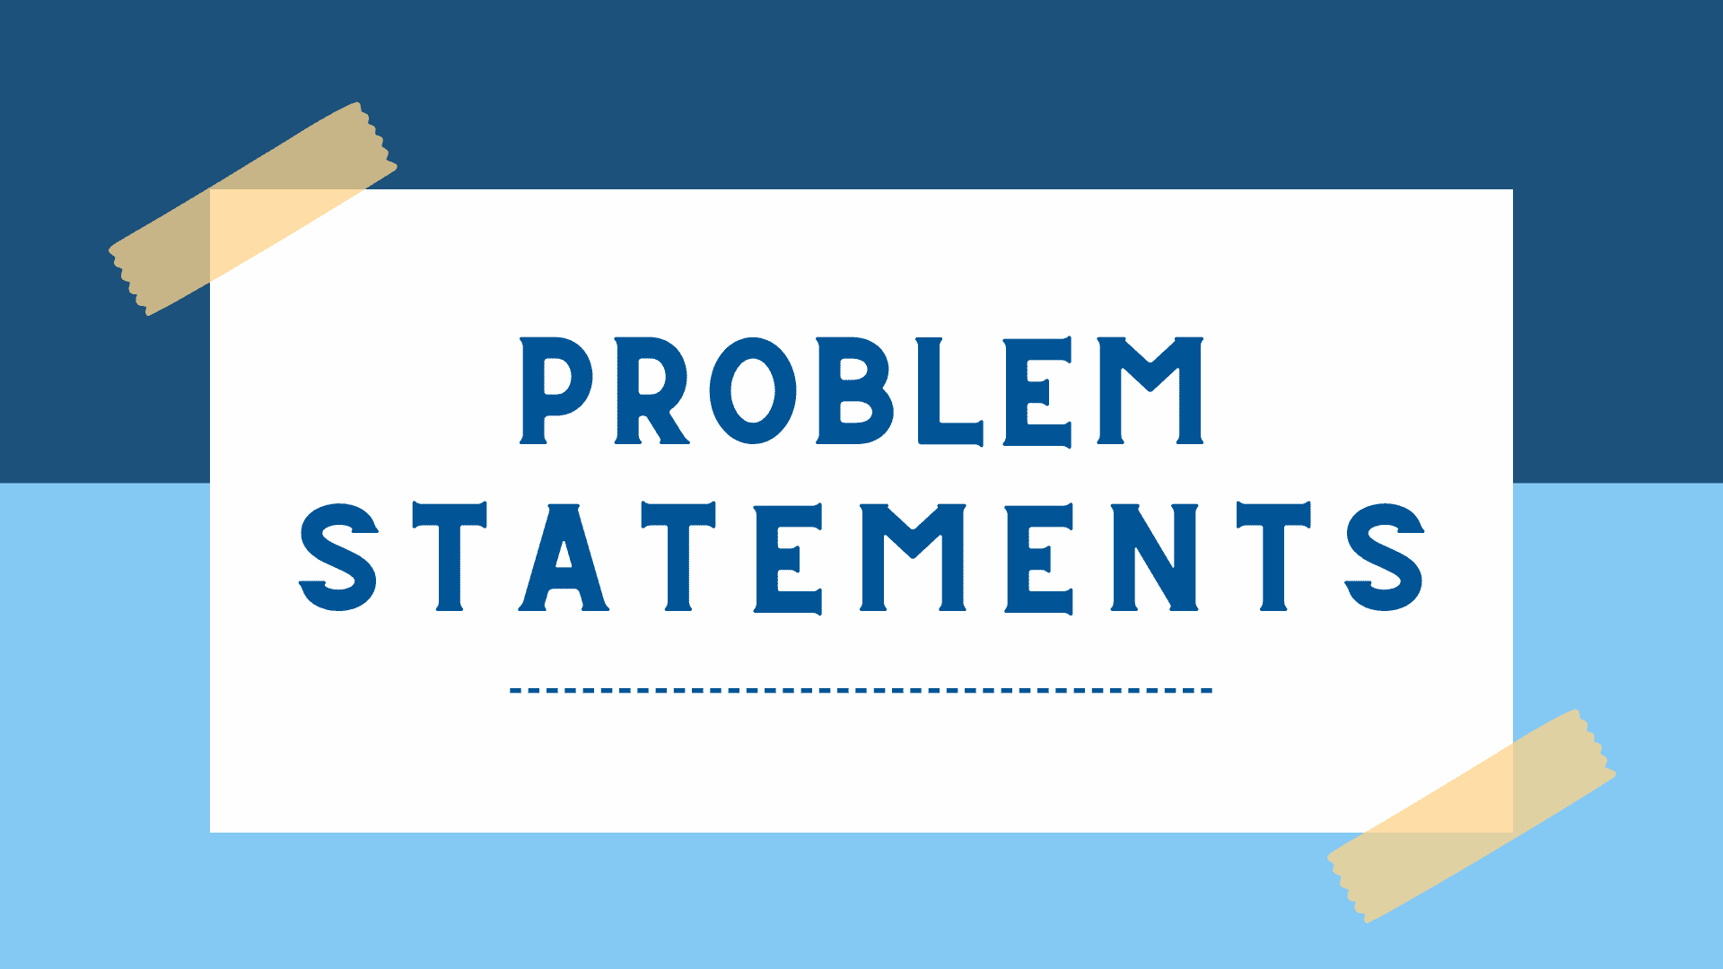
Problem Statement
Health issues like heart disease, diabetes, and obesity are on a rise, and understanding how life choices impact these conditions more than ever. This matters as early prediction of health risks is crucial and can help people make better choices and lead healthier lives.
It is commonly known in medicine that prevention is better than cure!

Slide 3
Strategies to take on the project
1.Data cleaning
Data cleaning
Data cleaning
2.Exploratory Data Analysis
Missing values and normalisation of life-related variables.
Exploring relationships between lifestyle factors and health outcomes.
3.Feature Engineering
Data cleaning
Data cleaning
4.Modelling
Aggregate health indices, lifestyle scores and demographic pro.
Logistic regression, k-Nearest Neighbours (kNN), tree-based models.
Data cleaning
Data cleaning
5.Evaluation
6.Insights
Use of precision, recall, and ROC-AUC as performance metrics.
Identifying major lifestyle factors and suggesting preventive measures.

Slide 4

Data Cleaning
Lifestyle variables such as exercise and diet should be normalised into one common system of measurement (e.g exercise per week).
Advantages:
It knows how important it is to organize and clean the data so everything makes sense.
Plans to fix any missing pieces of information to make the results more accurate.

Slide 5

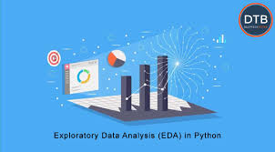
Exploratory Data Analysis (EDA)
Advantages:
Focuses on finding connection between things like exercise and health problems.
Uses graphs and simple tests to make patterns easier to see.
Tries to figure out the most important lifestyle habits for predicting health risks.
EDA involves seeking correlations between lifestyle factors and health outcomes such as type 2 diabetes, heart disease and obesity.
Visualisations such as Seaborn and Matplotlib will help uncover the correlation and association between poor diet or lack of exercise with increased risk.
EDA focuses on identifying the major lifestyle factors for modern development.

Slide 6
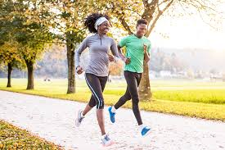

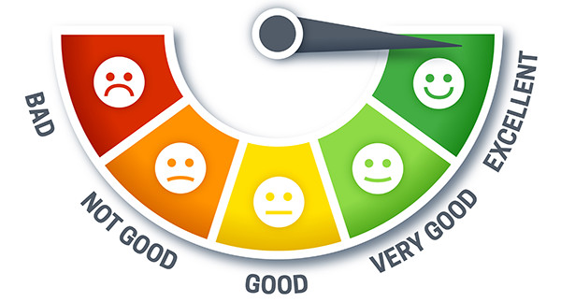
Feature Engineering
Feature engineering combines lifestyle factors into composite like a “Health Score” based on diet, exercise and smoking status. Furthermore, a demographic profile, including age and family history, can be added to enhance diabetes, heart disease and obesity risk.
Advantages:
Combines different health habits into a single score like a “Health Score” to make things easier.
Adds personal info like age and family history to make predictions accurate.
Health Score

Slide 7
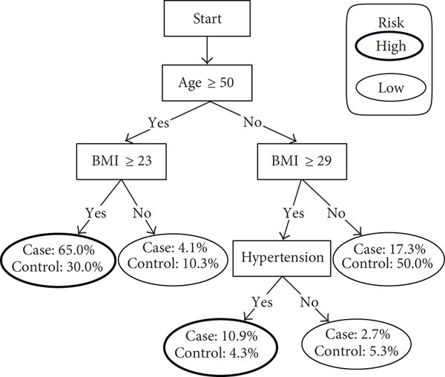
Modelling
Logistic regression and kNN classification use lifestyle factors to predict the likely hood of type 2 diabetes and heart disease.
Logistic regression provides probability, while kNN classifies individuals based on similarity with others.
Tree-based models, such as random forests, identify the most influential factors on type 2 diabetes and heart disease.
Advantages:
Tries different types of models (like logistic and regression and KNN) to find the best fit.
Uses models that not only predict but also explain why certain factors are important.
Includes models that help find out which health habits matter the most.

Slide 8

Evaluation
Evaluation metrics such as precision, recall, and ROC-AUC are used to assess model performance.
Precision and recall help measure the accuracy of positive predictions, while ROC-AUC demonstrates the model’s ability to distinguish between at-risk and not-at-risk individuals.
Advantages:
Picks tools (like precision, recall, and ROC-AUC) to see how good the predictions are.
Makes sure that the model can tell which people are at higher risk and which aren’t.

Slide 9

Insights
Major risks to diabetes and heart disease include low physical activity levels and poor dietary habits.
After modelling, recommendations can be made for promoting exercise and healthier eating.
Public health interventions can focus on these factors to reduce type 2 diabetes and heart disease.
Advantages:
Focuses on simple, helpful advice like exercising more or eating healthier.
Connects results to ways that communities can improve overall health.
Highlights that many health problems can be avoided with small changes.

Slide 10
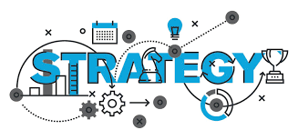
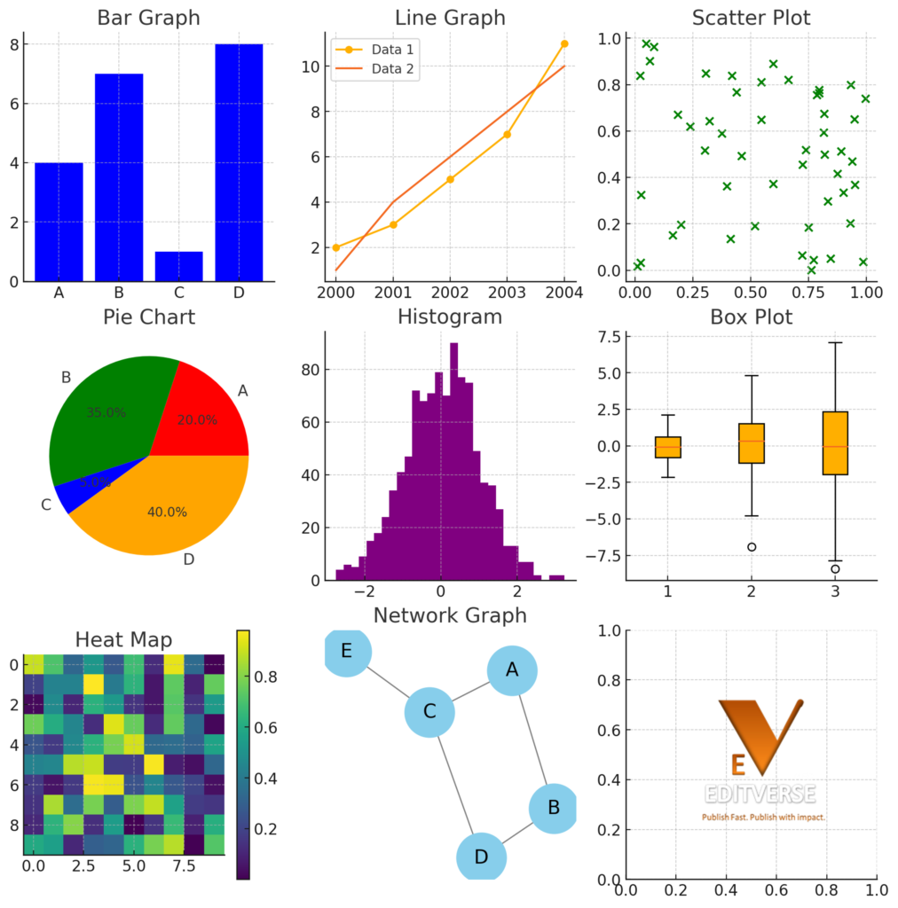
Our Strategy
Python will extensively help the project by using visualisation (Matplotlib and Seaborn) to evaluate the data set and help us view the data in a much clearer way and spot the correlations between activities and potential health risk. We’re aiming to use a variety of graphs and plots for the data set to spot different trends and factors, we’re specifically (histograms, scatter graphs, pie charts and line graphs). We’ve collected data regarding the possibility of disease with certain habits, what certain practices can be implemented in life to decrease these chances and different conditions that occur overtime.

Slide 11
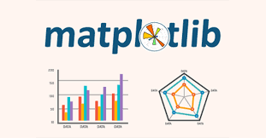

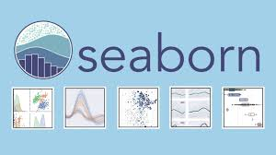
Visualizations and why we’re using them
Line graph-people in different age groups that are obese throughout the years.
Pie chart-percentage of suffering from a certain condition due to a certain lifestyle factors, (e.g what percentage of people that exercise are obese).
Histograms-Frequency of diseases and conditions in age groups that undergo certain lifestyle factors vs people that do not, (e.g how many smokers in different age groups have a heart disease vs how many non-smokers in different age groups have a heart disease).
Scatter graphs-how many people have a certain disease at different ages, (e.g number of people that have type 2 diabetes at different ages).

Slide 12



Innovation
As a group, we believe that our approach is unique as we will gain multiple data from our datasets to produce a variety of visualisations and analysis to each one accordingly to refer links between lifestyle factors and health conditions. Also, we think it’ll work as it’s statistically stated that over 95% of the world’s population has at least once encountered health issues, meaning that it is a topic of interest to everyone. Overall, the project can mainly help people with heart disease, diabetes and obesity.

Slide 13

Thank you for your attention!

